Slide 1

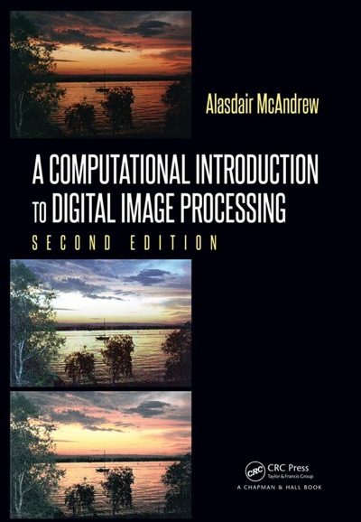
Chapter 1
Introduction to Digital Image Processing

Slide 2

Images and Pictures
Humans are predominantly visual creatures
Identification and classification –
faces, objects, …
Scan for differences –
amount of sunlight, shadows, …

Slide 3
Image Processing
Image processing involves changing the nature of an image in order to either
Improve its pictorial information for human interpretation
Render it more suitable for autonomous machine perception

Slide 4
Image Processing
Improve pictorial information for human interpretation
Examples:
Enhance edges
Remove/reduce noise
Remove/reduce motion blur

Slide 5
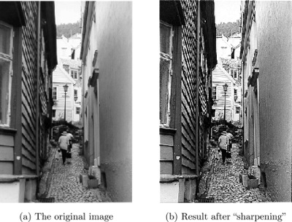
Image Sharpening

Slide 6
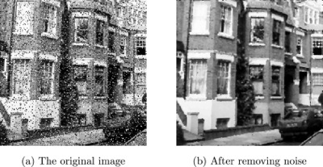
Removing Noise

Slide 7
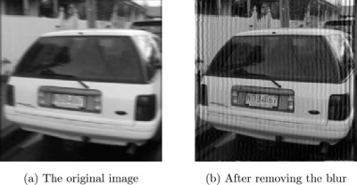
Image Deblurring
Notice the difference in the license plate

Slide 8
Image Processing
Render image more suitable for autonomous machine perception
Examples (easier to measure or count items):
Find edges
Remove/reduce detail

Slide 9
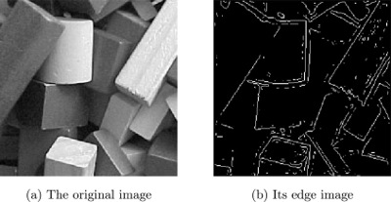
Finding Edges
May be used when measurements are important.

Slide 10
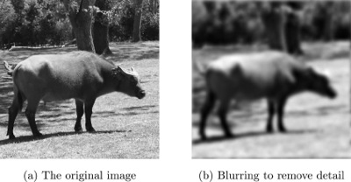
Blurring an image

Slide 11

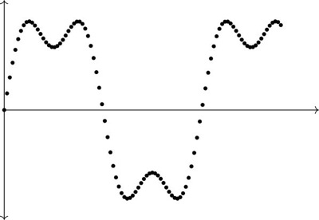
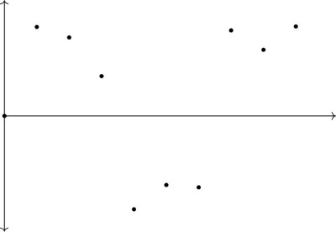
Image Sampling
Sampling refers to the process of digitizing a continuous function.
Undersampling: The number of points is not sufficient to reconstruct the function.
Undersampled
Sampled at 10 evenly spaced values of x
Sampled at 100 evenly spaced values of x

Slide 12
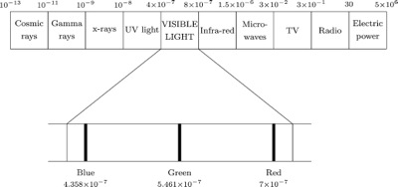
Image Energy Source
Visible Light – Digital Cameras, Scanners
X-Rays
Electronic beams

Slide 13
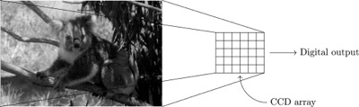
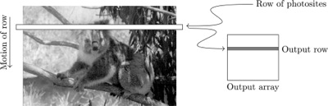
Image Energy Source
Digital Camera
Digital Scanner

Slide 14
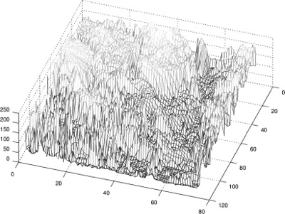
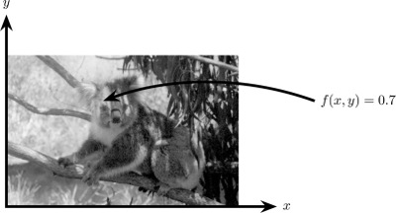
Image as a function
A monochromatic photo (that is, shades of gray only) can be considered as being a two-dimensional function, where the function values give the brightness of the image at any given point.

Slide 15
Image Processing Applications
1. Medicine
• x-rays, MRI, or CAT scans
• Analysis of cell images, of chromosome karyotypes
2. Agriculture
• Satellite/aerial views of land
• Inspection of fruit and vegetables
3. Industry
• Inspection of items on a production line
• Inspection of paper samples
4. Law enforcement
• Fingerprint analysis
• Sharpening or deblurring of speed-camera images

Slide 16
Image Processing Operations
Image enhancement: Processing an image so that the result is more suitable for a particular application.
• Sharpening or deblurring an out of focus image
• Highlighting edges
• Improving image contrast, or brightening an image
• Removing noise
Image restoration: Reversing damage done to an image
• Removing of blur caused by linear motion
• Removal of optical distortions
• Removing periodic interference

Slide 17
Image Processing Operations
Image segmentation: Subdividing an image into constituent parts, or isolating certain aspects of an image:
• Finding lines, circles, or particular shapes in an image
• Identifying objects, Ex. cars, trees, buildings, or roads
Image registration: Matching distinct images so that they can be compared, or processed together. The initial images must all be joined to share the same coordinate system.

Slide 18
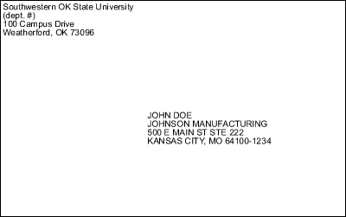
Real World Example
Obtain, by an automatic process, the postcodes from envelopes:

Slide 19
Real World Example
Obtain, by an automatic process, the postcodes from envelopes:
Acquire the image: Either by a Charge-Coupled Device (CCD) camera or a scanner.
Preprocess: Render the resulting image more suitable for next job. Ex. Enhance the contrast, remove noise, identify regions likely to contain the postcode.
Segmentation: Extract the postcode from the image.

Slide 20
Real World Example
Obtain, by an automatic process, the postcodes from envelopes:
Representation and description: Extract features which allow us to differentiate between objects - curves, holes, and corners, to distinguish the different digits that constitute a postcode.
Recognition and interpretation: Assign labels to objects based on their descriptors (from the previous step); assign meanings to those labels. Identify particular digits and interpret a string of four digits at the end of the address as the postcode.

Slide 21
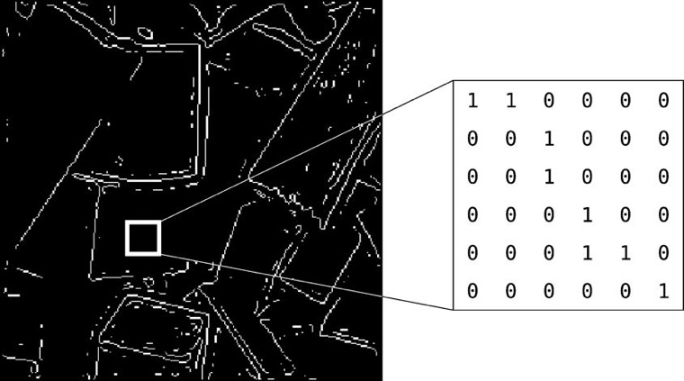
Types of Digital Images
Binary: Each pixel is just 0 (black) or 1 (white).

Slide 22
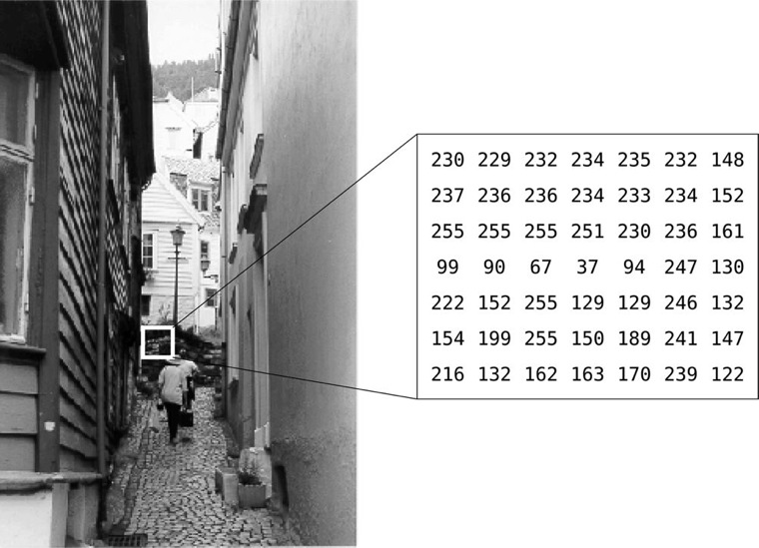
Types of Digital Images
Grayscale: Each pixel is a shade of gray, normally from 0 (black) to 255 (white).

Slide 23
Types of Digital Images
True color, or RGB: Here each pixel has a particular color; that color being described by the amount of red, green, and blue in it.
If each of these components has a range 0–255, there are 256³ = 16,777,216 different possible colors in the image.
The total number of bits required for each pixel is 24; also called 24-bit color images.
Can be considered as consisting of a “stack” of three matrices; red, green, and blue values for each pixel.

Slide 24
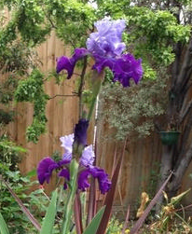
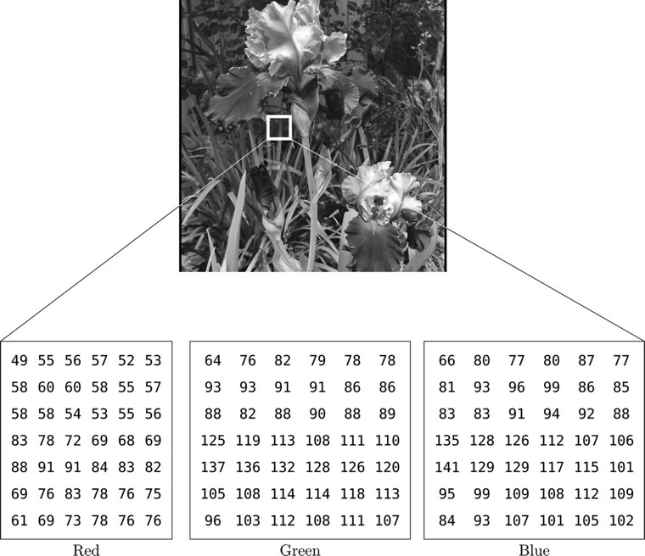
Types of Digital Images
True color, or RGB

Slide 25
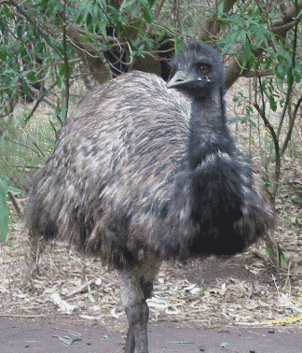
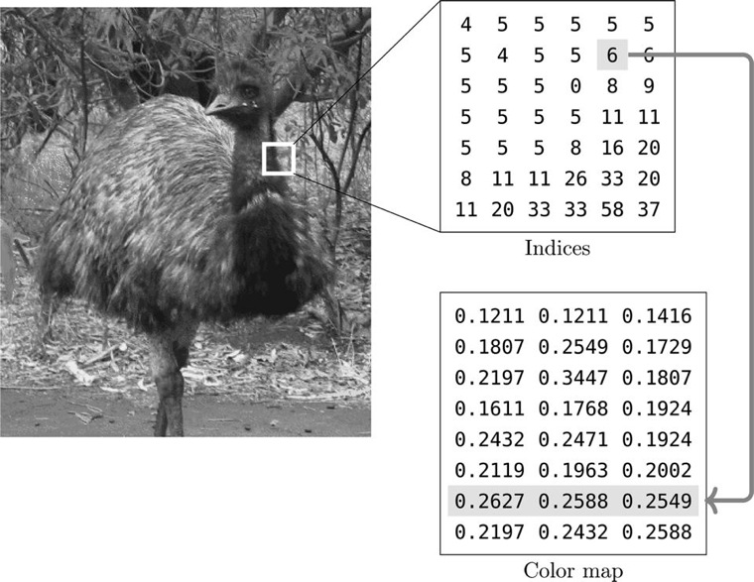
Types of Digital Images
Indexed: Image has an associated color map, or color palette, which is simply a list of all the colors used in that image.

Slide 26
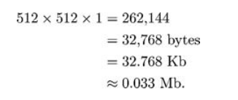
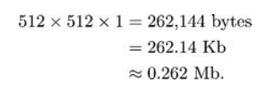
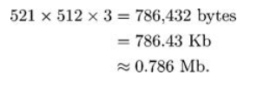
Image File Sizes
Consider a 512 × 512 image:
Binary: Grayscale: Color:
By convention approximation is used:
1 kilobyte = 1,000 bytes
1 megabyte = 1,000,000 bytes

Slide 27
Image Perception
Making an image appear “better” to human beings:
Steps:
1. Capturing the image with the eye
2. Recognizing and interpreting the image with the visual cortex in the brain
Considerations:
1. Observed intensities vary as to the background.
2. We may observe non-existent intensities as bars in continuously varying gray levels.
3. Our visual system tends to undershoot or overshoot around the boundary of regions of different intensities.

Slide 28

Image Perception
The two central squares have exactly the same intensity.

Slide 29
Image Perception
The two central squares have exactly the same intensity.

Slide 30

Image Perception
This image varies continuously from light to dark as we travel from left to right.

